Slide 1


IDS 1721
Computing and Problem Solving for STEM
Chapter 04
The Discrete versus the Continuous
Projectile motions

Slide 2

Projectile Motion
The motion will involve the following:
  Position
  Velocity
  Acceleration
  Time
We must be able to break down these quantities in 2D → horizontal and vertical

Slide 3
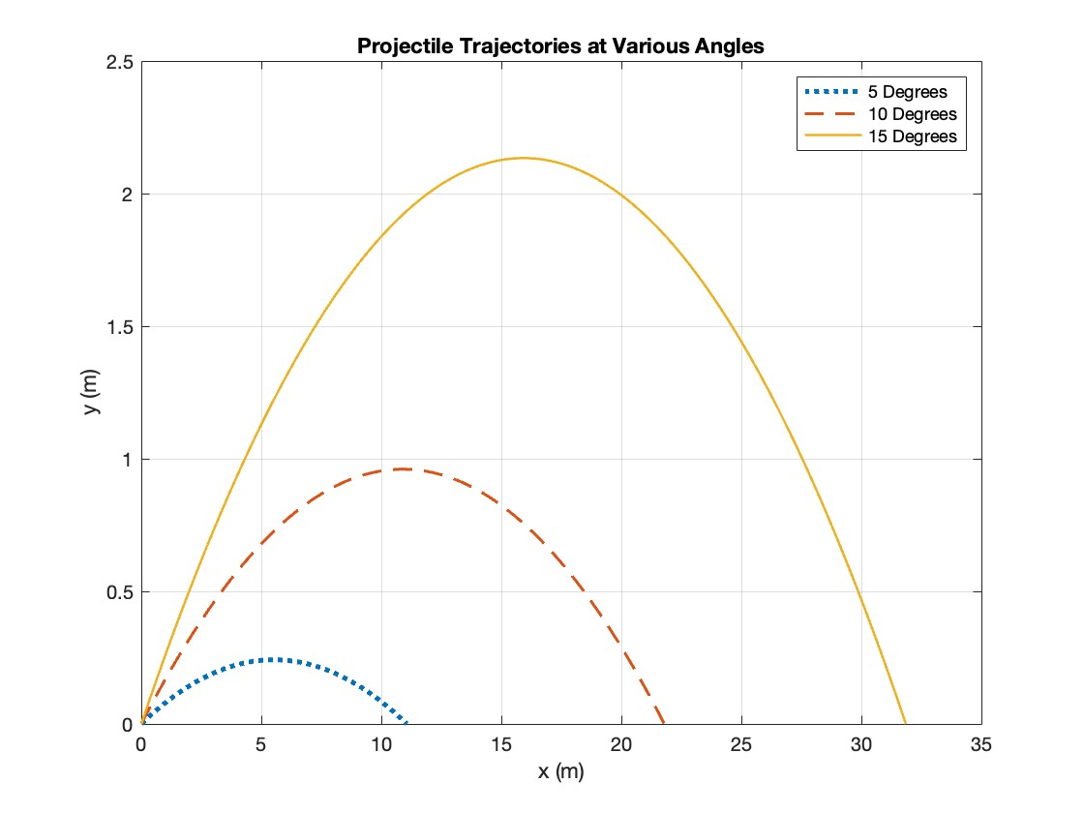
Projectile Motion

Slide 4
Projectile Motion – Flow Chart I
Initialize Variables
Initial x and y positions
Determine Final time of flight
Use the quadratic formula to determine the total time of flight
Create equally spaced time vector
Use the final time to create this vector via the linspace function
Define acceleration due to gravity
Define initial velocity and angle (in degrees)
Compute x and y position using kinematic equations
Also compute the max range and max height
Visualize trajectory
Graph x and y
Annotate plot (axis labels, grid, etc.)

Slide 5
Projectile Motion
Let’s break down our equations accordingly
Acceleration in the y-direction is going to be –g, thus our equation of motion in the y-direction will be:
We still need v_{x0} and v_{y0}
Acceleration in the x-direction is going to be 0, thus our equation of motion in the x-direction will be:
We’ll need to use some trig!

Slide 6
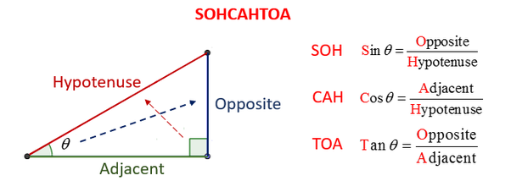
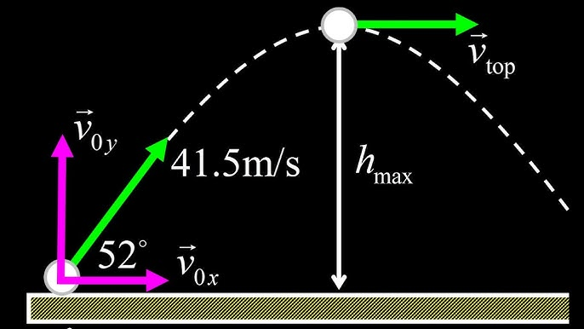
Projectile Motion
We can use: SOH CAH TOA
Thus, our equations can be modified

Slide 7
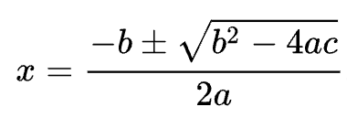
Projectile Motion
Our equations modify to:
How do we get the total time of flight?
Our equation is quadratic in t!

Slide 8
Projectile Motion
Let’s rewrite the y-equation
Final y-position is zero since the projectile lands back on the ground!
a b c
Why are we using the negative solution?
Next step is to write some pseudocode!

Slide 9
Projectile Motion
Pseudocode
Initialize variables:
  x0 =
  y0 =
  v0 =
  theta =
  g =
Define quadratic terms:
  a =
  b =
  c =
Determine total time of flight via quadratic formula
Determine time-step via linspace
Compute x and y positions
  x =
  y =
Compute max height and max range
  maxH =
  maxR =
Plot and annotate
Let’s code it up!

Slide 10
Projectile Motion
Pseudocode
Create a new script:
>> edit projMotion1.mlx

Slide 11
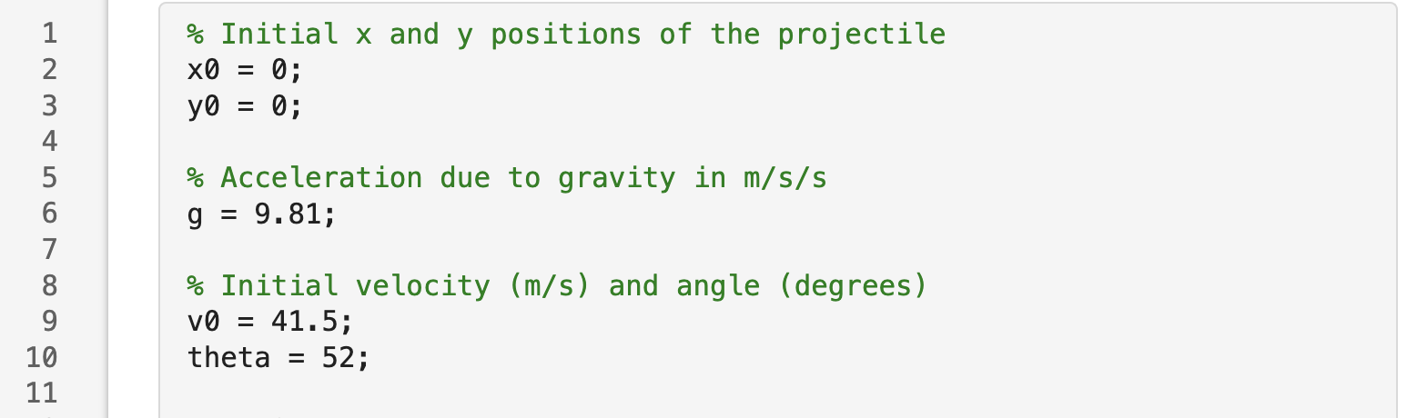
Projectile Motion
Algorithm

Slide 12
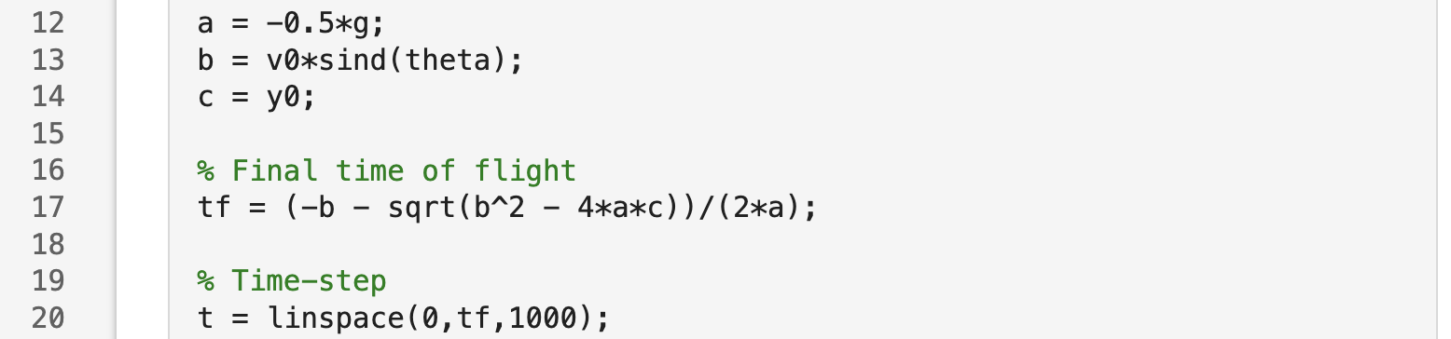
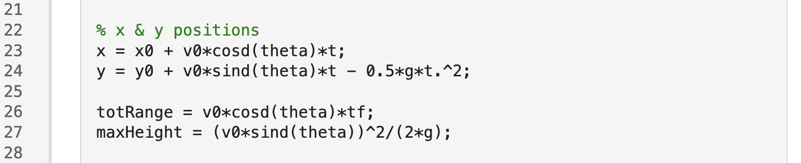
Projectile Motion
Algorithm
Notice the cosd and sind instead of cos and sin

Slide 13
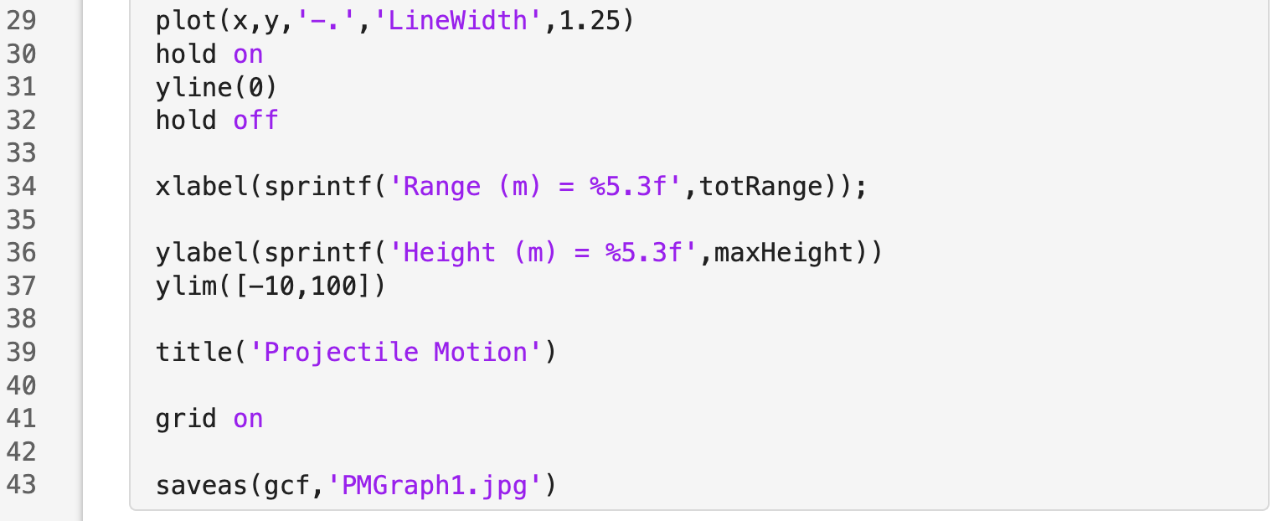
Projectile Motion
Algorithm

Slide 14
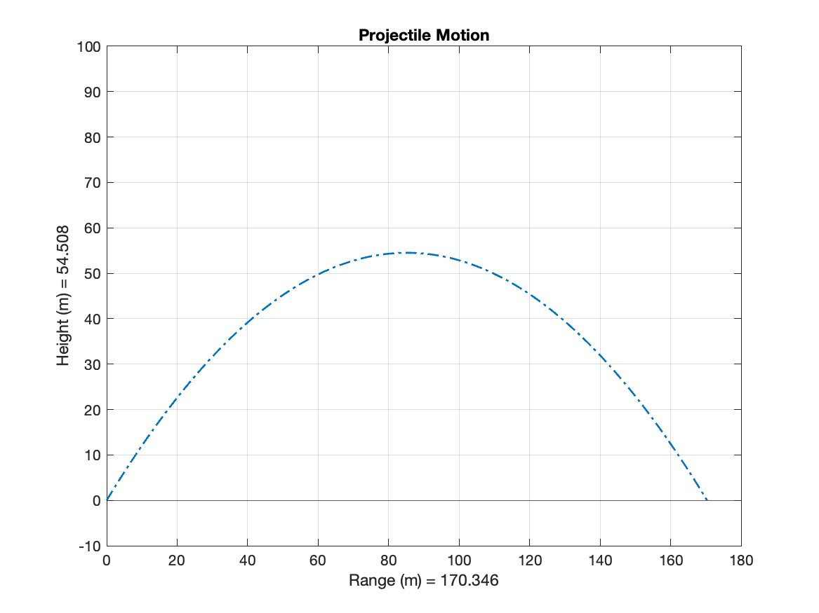
Projectile Motion
Results
Looks good!
How can we check?
We would have to index into the y-vector
Look at the last entry to ensure that it is zero or close to it!
What if the blue line passed the zero point?
Go ahead and try to do this on your own!
>> myCheck = y(end)

Slide 15
Projectile Motion
Results
We did this for one angle
What if we wanted to do this for multiple angles…
What do you think we need to do?
We can iterate!

Slide 16
Projectile Motion – Flow Chart I
Multiple Angles
Initialize Variables
Create a vector of angles
Create a figure
Use the figure function
Define acceleration due to gravity
Define initial velocity
Iterate over the vector of angles
Loop over the number of elements in the angle vector
Annotate graph
Use the hold on function to hold on for multiple plots
Compute v_{x0}, v_{y0}, x,y, and total time of flight
Visualize plots
Let’s code it up!

Slide 17
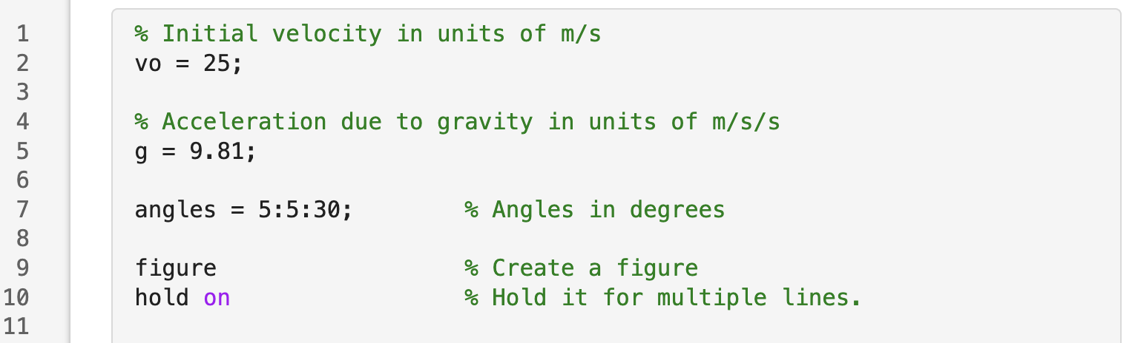
Projectile Motion
Multiple Angles
Create a new script:
>> edit projMotion2.mlx

Slide 18
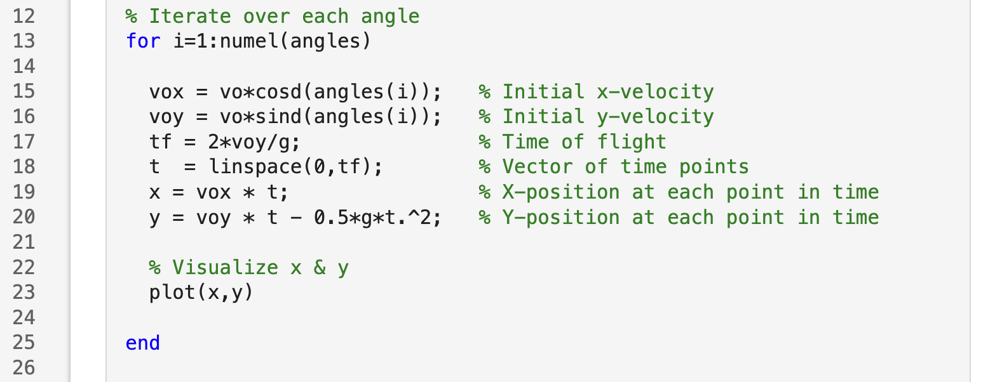
Projectile Motion
Multiple Angles

Slide 19
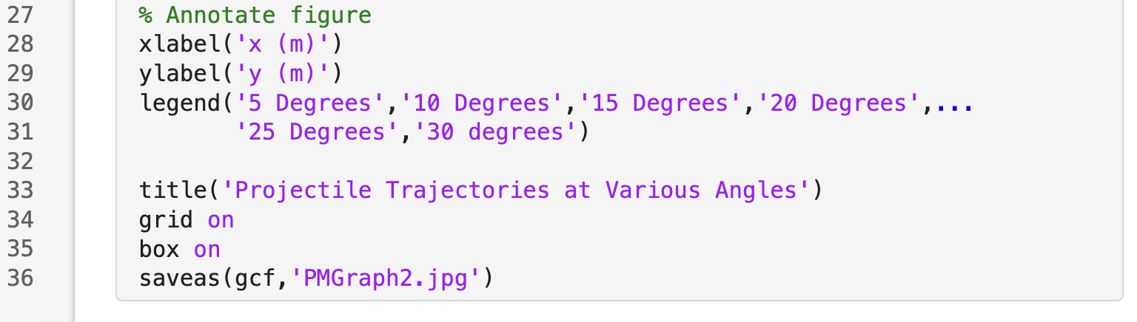
Projectile Motion
Multiple Angles

Slide 20
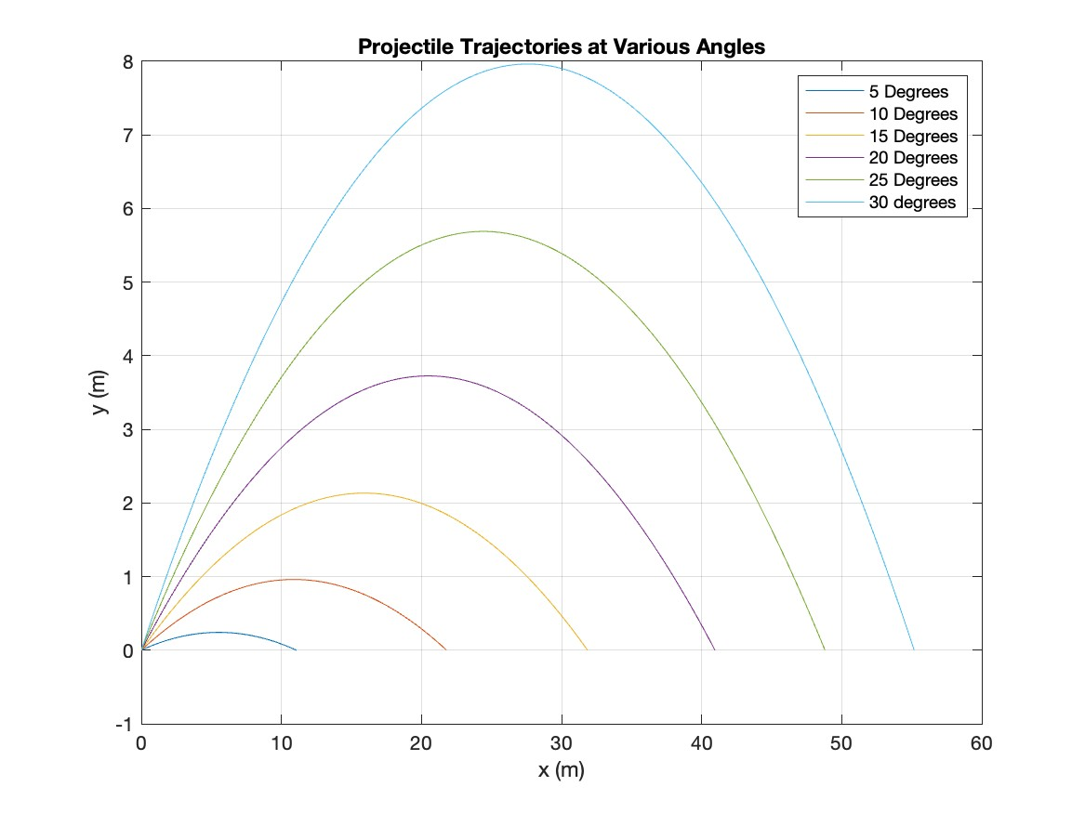
Projectile Motion
Multiple Angles– Results
Looks good!
What if I wanted to customize the plot?
Say, I wanted to change the color for each line.
How would I do this all at once?

Slide 21
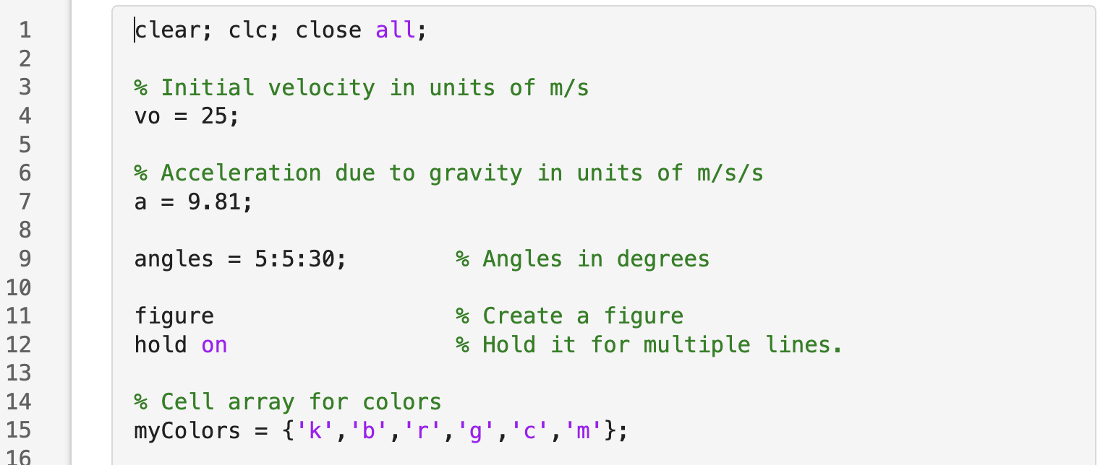
Projectile Motion
Annotations
I would need to create another array of character vectors of the color symbols.
And iterate over that array within my loop!
Modify your code and add line 15

Slide 22
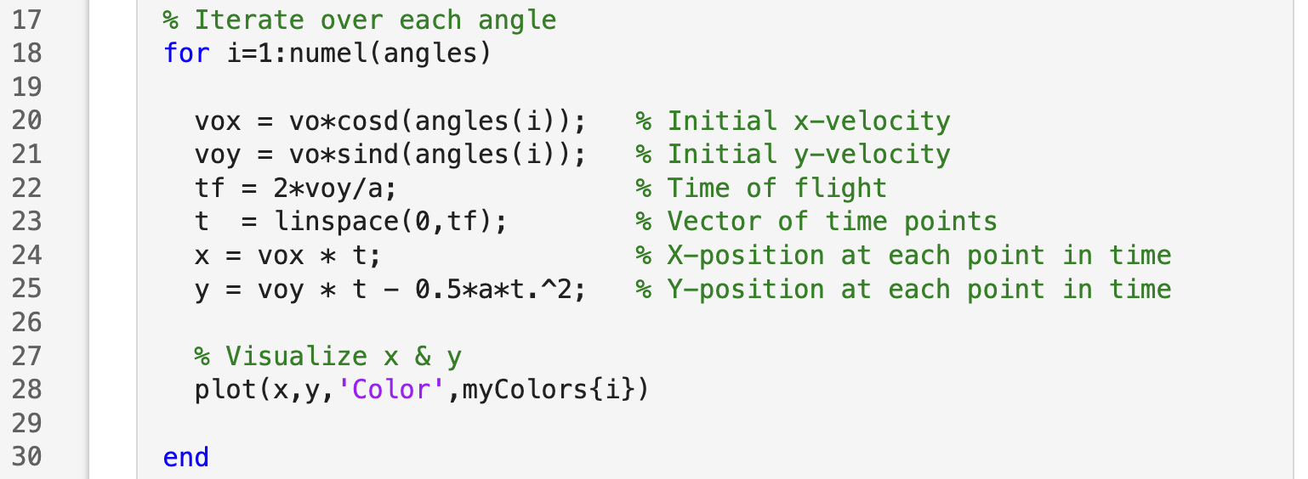
Projectile Motion
Annotations
I would need to create another array of character vectors of the color symbols.
And iterate over that array within my loop!
Modify your code with line 28

Slide 23
Projectile Motion
Annotations
You could do many others plot options such as changing the linestyle, linewidth, adding markers etc.
myLineStyle = {‘-’,’:’,’- -’}
myLineWidth = [1.25,1.5,1.75]
.
.
.
for i = 1:numel(angles)
  plot(x,y, ‘LineStyle’, myLineSyle{i}, ‘LineWidth’, myLineWidth(i))
.
.
.
end
Notice the curly braces { }
Notice the parentheses ( )
What do you think the difference is between the { } and the ( )?

